Slide 1
2 Peter 1:5-11
Notes:
But also for this very reason, giving all diligence, add to your faith virtue, to virtue knowledge, to knowledge self-control, to self-control perseverance, to perseverance godliness, to godliness brotherly kindness, and to brotherly kindness love.
For if these things are yours and abound, you will be neither barren nor unfruitful in the knowledge of our Lord Jesus Christ. For he who lacks these things is shortsighted, even to blindness, and has forgotten that he was cleansed from his old sins.

Slide 2
Growing in Holiness
in Light of the Promised Blessed Hope of the Lord and Savior’s Soon Return

Slide 3
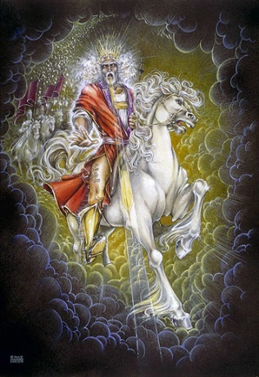
Growing in Holiness
2 PETER
The Blessed Hope is the certainty that our God and Savior Jesus Christ is retuning soon, just as He promised to rescue His church before the Day of the Lord, and at the very end the world is going to burn (3:10). In light of this Peter tells us how we should then live.
Notes:
The message of Second Peter is about hope.
Peter tells us to put our hope in Christ, to live in the expectation of the prophetic promises of Jesus’ soon return to establish His glorious kingdom on earth until the conclusion of all things, and then at that time He will create an new heaven and new earth in which only righteousness will exists.
The more we are rooted in this promise and hope, the more we ought to live in holiness, adding good moral conduct to our faith, persevering in the midst of personal trials, and developing our Christian character all in the expectation of being rewarded with a rich entrance to Jesus’ future kingdom without end.

Slide 4
Growing in Holiness
2 PETER
Key Verse:
“Therefore, since all these things will be dissolved, what manner of persons ought you to be in holy conduct and godliness” (2 Peter 3:11)
Notes:
“Therefore, since all these things (the heaven, the elements, the earth and the works that are in it) will be dissolved (loosen), what manner of persons ought you to be in holy conduct and godliness” (2 Peter 3:11)
Now just image, if people in all the churches today actually believed this truth, what effect it would have on their present conduct.
One of the Democratic presidential candidates stated its already to late, global warming has already effected our climate to the extent that we need to immediately start evacuating to higher ground. What if people really believe it. Would it not have an effect on their behavior. People are going green, to save the planet. But I don’t see or I have not heard of anyone moving to higher ground, not even the people who say that it’s a scientific fact. They apparently really don’t believe it either
Now, I’m not a climate change denier. I believe in global warming, just not man-made global warming, but God-made global warming. Right now I like, I love man-made climate changers, called air conditioners.
I heard one of the Apollo astronauts say that one of the reasons we need to explore outer space is so we can find a new planet for man to inhabit because someday, millions of years from now, the sun is going to explode and the earth with it.

Slide 5
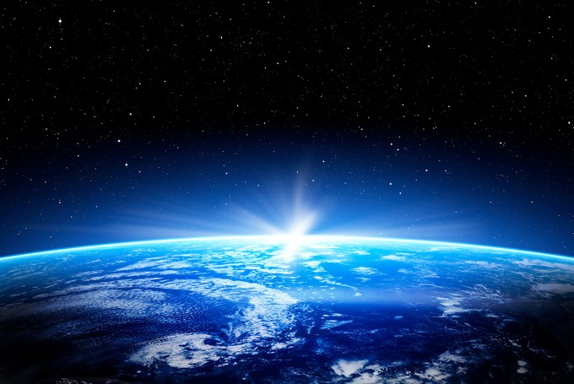
Growing in Holiness
2 PETER
A Verse of Hope:
“Nevertheless we, according to His promise, look for new heavens and a new earth in which righteousness dwell” (2 Peter 3:13)
Notes:
But humanity does not have to leave and move to the heavens, but heaven is going to come down to us and make all things new. Peter does not preach a pessimistic message of doom and gloom, but teaches a lesson of light appearing out of darkness, from doom to bloom. So listen, learn and live.

Slide 6
Growing in Holiness
2 PETER
The Prologue of the Letter – 1:3-11
The Basis of Holiness – 1:3-4
Notes:
Peter as a good shepherd is concerned about the moral character of his flock and the dangers that threaten them. He first reminds them of the basis of their holiness, the gracious provision of power and promises that God has provided for their growth in holiness (vs. 3-4) which are the foundational reason why we should follow through and add to our faith.

Slide 7
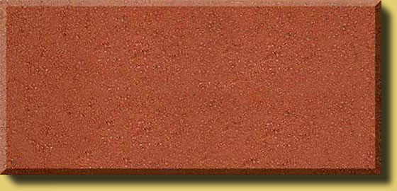
Growing in Holiness
2 PETER
The Prologue of the Letter – 1:3-11
The Basis of Holiness – 1:3-4
PARTAKE
POWER
PROMISE
KNOWLEDGE BASED FATIH
GOD’S GLORY AND VIRTUE
Notes:
Its because of God’s Person, His glory, His moral excellence, holiness and His love for us, that makes everything possible. It is the deepest foundation in whom we trust.
God’s is love, it is the reason that He loved the world and sent His Son as the provision for our salvation. Our faith is based in the knowledge of Christ’s person and provision and proclamation. It is by the means of faith in Christ’s person and His provision that was proclaimed to us, that we received eternal life.
Faith in Christ is also the means by which we are now made recipients of a spiritual equipping and empowering. It is knowledge based faith in Christ that is the means by which we can now access God’s power and promises.
It is God’s divine power that has sufficiently gifted us with all things related to life and godliness. Spirit born believers have all that they could possible need to live a godly life. Nothing else is needed.
God has also given us “exceedingly great and precious promises.” God has given us the promise of eternal life by believing in Christ person, provision and proclamation. In Peter’s second letter the promises that he has most in mind are the promises that God has given us in order that we live godly in this life. And these promises, along with his power, are also the means by which we can become partakers of God’s nature.
What promises are these? At the very least, they must be the prophetic promises of the coming “parousia” of the Lord Jesus Christ, so strongly emphasized in this letter, which Peter had already previously made know to them in the first letter (1:16.) It includes the promise of His physical coming “erchomai” to the earth, in which at that time every eye on earth will see Him and the “apocholips” the revelation, the unveiling and uncovering of the Lord Jesus Christ will be made complete and all of the accompany events.
And especially Peter has in mind the promise of a new heaven and earth in which only righteousness dwells, where there will no sin. At that time he will “wipe away every tear from their eyes; there shall be no more death, nor sorrow, nor crying. There shall be no more pain, for the former things have passed.” (Rev. 21:4)
It is through these very great and valuable promises that we discover God’s purpose in given them, so that we can “participate”, “become partners” or “sharers” in God’s nature. God’s gift of divine power and promises are the means by which we can partake in His divine nature and work.
One of the great lessons of second Peter is that to maintain a holy life in a corrupt world like ours, we must be deeply rooted in the prophetic promises of God’s word. We must hold fast/stand to the “blessed hope” of the return of our Lord and Savior Jesus Christ. Failing to do so only leads to an absence of readiness.
The promise of His return has are extremely valuable and importance reliance to our growing in holiness. What we believe concerning His coming has great implications for our life now and in the future.
.

Slide 8
Growing in Holiness
2 PETER
LOVE
BRO. KINDNESS
GODLINESS
The Characteristics
of Holiness – 1:5-7
PERSEVERANCE
SELF CONTROL
KNOWLEDGE
VIRTUE
FAITH
Notes:
But we need to know what that divine nature looks like, so Peter gives us the characteristics of holiness, telling us to diligent to add to our faith.

Slide 9
Growing in Holiness
2 PETER
LOVE
“For if these things are yours and abound, you will be neither barren nor unfruitful in the knowledge of our Lord Jesus Christ. (1:8)
BRO. KINDNESS
GODLINESS
PERSEVERANCE
SELF CONTROL
KNOWLEDGE
VIRTUE
FAITH
Notes:
And if we add or apply these characteristics to our lives we will become ever increase fruitful and productive in favor and knowledge of our Lord Jesus Christ.

Slide 10
Growing in Holiness
2 PETER
LOVE
“For he who lacks these things is shortsighted, even to blindness, and has forgotten that he has been cleansed from his old sins.” (1:9)
BRO. KINDNESS
GODLINESS
PERSEVERANCE
SELF CONTROL
KNOWLEDGE
VIRTUE
FAITH
Notes:
Peter adds that he who lacks these things is shortsighted and blind, forgetting that he was saved.
Shortsighted (“nearsighted”) people cannot see very far in front of themselves. They have difficulty seeing these in the distance. Peter has in mind those who have shortsighted views of the coming of the Lord Jesus Christ in terror and in glory in the future. Peter already knows that there are many, including the deceiver himself, who wants to get our eyes off the future and give all our attention the immediate, there’re “the now crowd”. The false teachers are here now and are coming in increasing numbers. Therefore, Peter writes this second letter as a permeant reminder and warning not be caught off guard.
There are many “shortsighted/nearsighted” false teachers that Peter, as a good shepherd, must warn his flock concerning the coming of our Lord.

Slide 11
Second Coming
2 PETER
“this generation?”
Assuredly, I say to you, all these things will come upon this generation. "O Jerusalem, Jerusalem… See! Your house is left to you desolate; (Mt. 23:36-38)
“Assuredly, I say to you, this generation will by no means pass away till all these things take place.” (Mt 24:34-35)
Notes:
We focused on attention on the phrase “this generation”. Jesus predicts the destruction of Jerusalem in Matthew chapter 23 and says that its destruction will occur within the lifetime of those who were living in Jerusalem at that time. No one disputes this. This is a fact of history that took place in the past.
But then later after Jesus had given a long list of signs for the end of the age, and the sign of the coming of the Lord in the clouds, He said again “this generation will by no means pass away till all these things take place.” (Mt. 24:34) The question is, which generation was He referring too? Was He referring to the same generation or another?
The Preterits also argue that all of the events surrounding his 2nd Coming describe in chapter 24 will also take place within that same generation. In other words, all the event described are signs of the coming destruction of Jerusalem which were completed by AD 70. Therefore, everything here is describing past events.
But notice when does Jesus say “all” these things will take place—verse 34, this verse follows verse 29-31 describing the sign of the Son of Man and His coming when every eye will see Him. That is why full preterists believe that Jesus has already Come, and this is why they call partial preterits inconsistent preterits. As you can see and hear it can get pretty convoluted.
But here is the solution, its actually very simple.

Slide 12
Second Coming
2 PETER
“this generation?”
Let’s Make A Choice
Notes:
In order to assist us in our decision we took a spinoff on a popular game show “Lets’ Make a Deal”. Instead we playing “Let’s Make a Choice”… But this is no game, this is real life, with real life consequences to what we believe, for the present and the future.

Slide 13
Second Coming
2 PETER
“this generation?”
Past
Present
Future
Preterits
Historicist
Futurist
“Already”
“Now”
“Not Yet”
Notes:
We already saw that there are three major options from which to chose from, either He’s referring to a past generation, or a present generation, or a future generation. The past option is called the “Preterits” view, sometimes called Realized Eschatology”, the present option is called the “Historicist” view, and the future option is called the “Futurist” view. Another way of describing it is “already”, “now” and “not yet”.

Slide 14
Second Coming
2 PETER
“this generation?”
Signs of the Destruction of Jers. are also the Signs
of the End of the Age
Mt. 24:4-28
Luke 21:20-24
Rev. 6-18
Sign of His Coming
Mt. 24:29-31;
Luke 21:25-28
PAST
? Y
E. S.
“New Israel”
Millennium
(Transition)
AD 70 “=“ Tribulation/70th Seven
“somehow”
?
[“this generation”]
Notes:
The Preterits argue that all of the events surrounding his 2nd Coming describe in chapter 24 will also take place within that same generation. In other words, all the event described are signs of the coming destruction of Jerusalem which were completed by AD 70. Therefore, everything here is describing past events.
The Full or Consistent Preterits also say that the “all these things that will take place” includes the Second Coming of Christ, the resurrection of the dead and the final judgments, leaving nothing yet to be fulfilled. The end of the age and the end of all things is a thing of the past.
Partial or Inconsistent Preterits say that only the Second Coming, the resurrection of the dead and the final judgments are the only remaining events yet to be fulfilled, along with the restoration of the earth, but not the destruction of the earth.
.

Slide 15
Second Coming
2 PETER
“this generation?”
Signs of the Destruction of Jers. Luke 21:20-24
Sign of His Coming
Mt. 24:29-31;
Luke 21:25-28
PRESENT
Signs of the End of the Age
Mt. 24:4-28; Rev. 6-18
E. S.
? Y
(Transition)
“New Israel” - Trib. & Millennium
AD 70
Tribulation/70th Seven
Coming Unknown
[“this generation”]
Notes:
The Historicist view sees the signs of the end of the age being fulfilled throughout church history up to the present. They are also still looking for the Second Coming, etc. yet to be fulfilled in the future.

Slide 16
Second Coming
2 PETER
“this generation?”
Sign of the Soon Destruction of Jers.
Luke 21:20-24
(? #1)
“But before all these things” Lk. 21:12
Sign of His Coming
Mt. 24:29-31
(? #2)
FUTURE
Signs of the End
of the Age
Mt. 24:4-28/Lk 21:8-11
Rev. 6 (? #3)
Church Age
AD 70
? Y
Tribulation/70th Seven
“and”
[“this generation”]
[“this generation”]
Notes:
Futurists understand that Jesus used a chiasm and answers the disciples questions in reverse, beginning with “what are the signs of the end of the age”, then “what the sign is of His Coming” and he actually does not answer the third question in the Gospel of Matthew concerning “what the sign is of the soon destruction of Jerusalem and the temple”. Matthew focus only on the “when” issue concerning the “Parousia”, the Coming, and the day of the Lord, in verses 36-4, which He says no one knows when “that day” our “that hour” of the Lord will begin.

Slide 17
Second Coming
2 PETER
“this generation?”
Sign of the Soon Destruction of Jers.
Luke 21:20-24
Signs of the End
of the Age and Coming
Mt. 24:4-31/Rev. 6-19
“before these things”
Temple, City, Nation
Destroyed
Temple, City, Nation Saved (Lk. 21:28)
AD 70
Tribulation/70th Week
“and”
[“this generation”]
[“this generation”]
Notes:
So it is plainly clear that “this generation” refers to two different “generations” with two totally different outcomes. One describing events the surrounding the destruction of Jerusalem in the past and one describing in part the events surrounding the salvation of the nation of Israel and its capital city in the future.
The Tribulation temple and the sacrifices that the Jews will be offering is not recognized by God, for Christ already made the final sacrifice and the veil was ripped opening the way to God. This temple will be the center of false religion, especially during the second half of the tribulation when the anti-Christ places a statue of himself in the holy of holies, making himself out to be God, and which the false prophet will demand all to worship Him.

Slide 18
Second Coming
2 PETER
PRESENT ?
FUTURE
Coming
“erchomai”
Church Age
End Age
“Age of Grace/Patience”
“peace and safety”
“days before the flood”
“Age of Terror”
Tribulation/70th Seven/Flood
“The Day of the Lord”
NO sign or knowledge of His Parousia or “that day” (of the Lord) or “that hour”
Signs of the End; Knowledge of His Coming “erchomai” is Near
“Parousia” -- Coming
Notes:
Futurist views the “Parousia” or “The Coming”, the signs of the end of the age and of His coming or appearing in the clouds as a future event, when He will at that time establish His earthly reign on the earth for 1000 years.
We presently living in the pause… the age of grace and patience waiting for His Nearing… In the mean time we are to be watching and preparing for His immanent return to rescue the church which He promised from the age of terror, “In that day a man will cast away his idols of silver and his idols of gold, which they made, each for himself to worship, to the moles and bats, to go into the clefts of the rocks, and into the crags of the rugged rocks, from the terror of the Lord and the glory of His majesty, when He arises to shake the earth mightily.” (Isa. 2:20-21)
parousia (par-oo-see'-ah); a being near, coming, presence from “pareimi” – “para” – near; “eimi” – exist.
“erchomai” (er'-khom-ahee); to come or go, This is the coming with the clouds, when every eye will see Him.

Slide 19
Second Coming
2 PETER
“this generation?”
Past
Present
Future
Preterits
Historicist
Futurist
“Already”
“Now”
“Not Yet”
Notes:
Another very important fact in determining which door/view/perspective you chose has to do with Hermes.

Slide 20
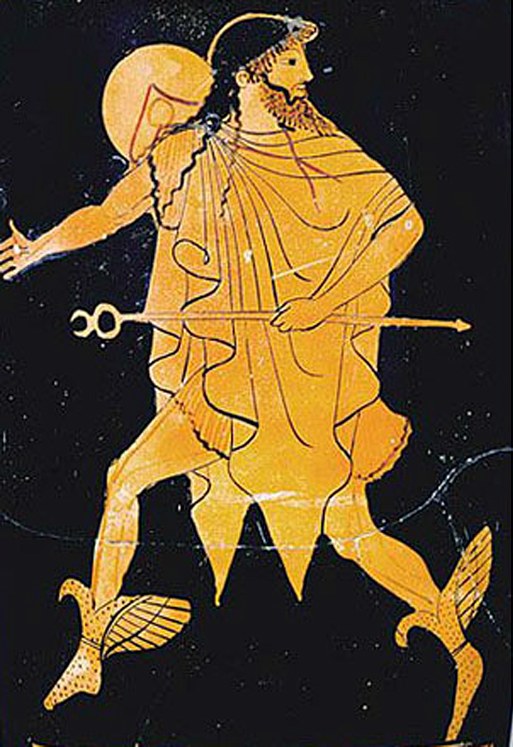
Second Coming
2 PETER
“this generation?”
Hermes
A son of Zeus, the messenger of the gods; the god of trade, travel, commerce;
the gate keeper
Notes:
Another very important fact in determining which door/view/perspective you chose has to do with Hermes.

Slide 21
Second Coming
2 PETER
“this generation?”
Hermeneutics
Sets the rules of interpretation, like a gate keeper, in our understanding of the message.
Notes:
Hermes is where we derive the word “Hermeneutics”. Hermeneutics is the method of interpretation that is applied to the Scripture message by which we determine it meaning. It sets the rules of interpretation, like a gate keeper, in our understanding of the message.

Slide 22
Second Coming
2 PETER
“this generation?”
Two Methods
Allegorical and Spiritual Method
Historical- Grammatical Method
Notes:
There are two opposing methods, or gate keepers, that when it is applied to the message/Scripture will determine its meaning. And they also, depending on which method of interpretation you chose, will determine which door or view of the Second Coming you will chose. The two methods of interpretation are the less literal “Allegorical and Spiritual Method” and the more literal “Historical-Grammatical Method”.

Slide 23
Second Coming
2 PETER
“this generation?”
Past
Present
Future
Preterits
Historicist
Futurist
Allegorical and Spiritual Method
Historical- Grammatical
Notes:
If you chose the “Allegorical and Spiritual Method” then, more like than not, you will chose the “shortsighted” Past or Present view. On the other hand, if you chose the “Historical-Grammatical Method” of interpretation, then more like than not, you chose the farsighted Future view.
Now, the “Historical-Grammatical Method” was the method of interpretation by the earliest church fathers Irenaeus of Lyons, Papias of Hierapols, Aristion, the elder John and Justin Martyr. As a result they adopted a Futurist view of the prophetic events.
“Allegorical and Spiritual Method” was the method of interpretation that was adopted by many of the early church fathers beginning in the 3rd century AD. Beginning with Clement of Alexandria and Origin, also Ambrose who tutored Augustine who was attracted to the spiritual interpretation of the kingdom. Augustine’s spiritual view and his allegorical method of interpretation would dominate and become the normal Roman Catholic view to this day. As a result they adopted a view of the future that was more Preterits and Historicist in nature and a view of the kingdom that was less material, more spiritual and mystical.
A major factor for this shift has do with the Greek culture from which they came. Greek philosophy had an tremendous influence on them and their Christian doctrine. So much so that they merged their Christianity with the ideas of Plato. According to Randy Alcorn they largely replaced their biblical view with what he has coined Christoplatonism, a mixture of Christian and Plato’s ideas. Plato taught that there was a dualism between matter and the immaterial, and that matter was inferior to the spiritual.
This leads me to ask the question, “Who came first, Plato or Christ?” First, who was Plato? A Greek philosopher who lived in the 3rd century BC. some 300 years or so before Christ. So, historically, Plato came first. But did you know that Plato came first biblically before Christ? Clement believed that God used philosophy to prepare the Greeks for Christ, just like the law of Moses prepared the Jews for Christ. Plato served the role of tutor, similar to that of Moses.

Slide 24
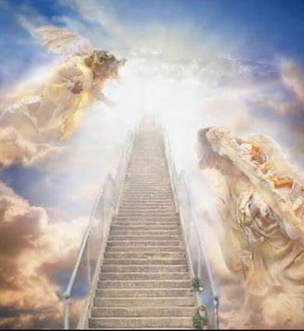
Second Coming
2 PETER
Two Models
Spiritual Vision
New Creation
Notes:
As a result, according to Craig Blaising, there have been two broad models of eternal life that have been held by Christians since the time of the early church. The two models are, “the Spiritual Vision Model” and “The New Creation Model” [Craig B. Blaising, “Premillennialism” in Three Views of the Millennium and Beyond, ed. Darrel L. Bock (Grand Rapids: Zondervan, 1999), 161.]

Slide 25
Second Coming
2 PETER
Two Models
Spiritual Vision
The Kingdom is an Inner Spiritual Experience
Influenced by Platonism
Spirit is Superior to the Material
Linked to the Allegorical and Spiritual Method
Plato a Tutor?
Notes:
The Spiritual Vision Model has been heavily influenced by the Greek philosophy, namely Platonism, named after Plato who lived in the 3rd century B.C. Platonism had an tremendous influence on many church fathers and Christian doctrine. So much so that they merged their Christianity with the ideas of Plato. According to Randy Alcorn they largely replaced their biblical view with what he has coined as Christoplatonism. He points out, “this merger was not a good thing since this mixture of Platonism with Christianity has poisoned Christianity and blunted its distinct differences from Eastern religions… Christoplatonism’s pervasive influence has caused many Christians to resist the many biblical truths, such as bodily resurrection of the dead, a future punishment of the wicked, a earthly kingdom where people will work, rule and play. And it has had a devastating effect on our ability to understand what the Scriptures says about Heaven, particularly about the eternal Heaven, and the New Earth. This is supported by a statistic from Time magazine which states that two-thirds of Americans who believe in resurrection of the dead do not believe they will have resurrected bodies. [Randy A. Alcorn, Heaven (Sandy, OR: Eternal Perspective Ministries, 2004)
Plato taught that there was a dualism between material matter and the immaterial; that matter was inferior to the spiritual or the spirit is superior to the material. He viewed the ‘higher’ spiritual world as essentially separate form the material world. Plato had a disdain for things material. Combining Christianity with Platonism lead many to a denial of a future material and earthly kingdom on earth, held by early Christians.
This leads me to ask the question, “Who came first, Plato or Christ?”. Historically, Plato came first, who lived some 300 years or so before Christ. But did you know for many Plato came first biblically? Clement believed that God used philosophy to prepare the Greeks for Christ, just like the law of Moses prepared the Jews for Christ. Plato served the role of tutor, similar to that of Moses.
Many who adhere to the Spiritual Vision Model see the kingdom of God as primarily an inner spiritual experience. Many are not preparing for New Earthly existents in the future. A kingdom that is characterized as ‘heavenly’ and ‘spiritual’, not ‘earthly’ and ‘political’ smacks more of Platonism than biblical truth.
Some scholars (Amillennialist Hoekema and Riddlebarger) take offence that they are mixing Christianity with Greek philosophy, affirming they believe in a coming physical new earth, a physical resurrection and a physical return of Christ. But Michael Vlach, the author of the article “Platonism’s Influence on Christian Eschatology” says they are being inherently contradictory and inconsistent. But that is exactly why Christoplatonism is what it is, a mixture of Christianity and Platonism.
And lastly the Spiritual Vision Model is inherently linked to an allegorical and spiritual method of interpretation that is opposed to the more literal interpretation based on the historical-grammatical contexts. A spiritual interpretation is often opposed to the literal meaning of words as they were expressed by the original author. The Spiritual Vision Model becomes sometimes highly subjective and arbitrary.

Slide 26
Second Coming
2 PETER
Two Models
Contrary to Radical Dualism
New Creation
A Regenerated Creation
Emphasizes Physical, Social, Political, and Geographical Aspects of Eternity
Heaven Comes to Transform and Renew the Earth
Notes:
The New Creation Model is contrary to radical dualism [Platonism] and the Spiritual Vision Model and emphasizes the physical, social, political and geographical aspects of eternal existents.
It emphasizes a coming new earth, the renewal of life on this new earth, bodily resurrection, and social and political interaction among the redeemed. Eternal life is essentially continuous with that of present earthly life except for the absence of sin and death. Thus, eternal life is embodies life on earth. It does not reject the physical or the material. It does not see them as inferior to the spiritual, as Neo-Platonism does.
The New Creation Model see a redeemed and regenerated creation. “The New Creation Model emphasizes the future relevance of matters such as renewal of the world and universe, nations, kings, economics, agriculture and social-political issues… Life in the future kingdom of God will be largely similar to God’s original purposes for the creation before the fall of Adam, which certainly involved more that just a spiritual element.”
The good news is that heaven comes down to transform and renew the earth. “…the eternal destiny of the redeemed includes a holistic renewal of human existence and our environment.

Slide 27
Second Coming
2 PETER
Conclusion

Slide 28
Second Coming
2 PETER
Two Models
Spiritual Vision
New Creation
Notes:
The question is which model will you chose? And…

Slide 29
Second Coming
2 PETER
“this generation?”
Past
Present
Future
Preterits
Historicist
Futurist
“Already”
“Now”
“Not Yet”
Notes:
Which door will you chose? There will be winners and losers in this game of life. If you chose poorly and are unprepared for the future their will be lose even for the believer. Not a loss of eternal life, but a lose none the less.
If a thief is presently breaking into your home as I speak, and you were bot prepared, you have not taken any measures to deter that thief, like an alarm system, I can guarantee you that when you return you will find something of value missing. You will lose something of value.
If Jesus was to return now as I am speaking and you have not taken measures to prepare for His imminent return to snatch up the church just as He promised then you will also experience loss.

Slide 30
Second Coming
2 PETER
The Blessed Hope
Loser
Winner
The Loss of the Joy of Serving Christ
The Privilege of Ruling with Christ
An Abundant Introduction into His Kingdom
Loss of Reward, Praise and Honor
Notes:
The are two things the imagery of the thief illustrates about the Parousia of the Lord and the coming day of His wrath, is that-- 1) we do not know when His nearing will be and, 2) if we are not prepared, watching and on the alert, working to diligently adding to our faith, serving the Lord, their will be a loss involved. There will be loss certainly for the unbeliever, but also for the believer.
The loss of the joy of serving Christ in His future eternal kingdom on the New Earth, and the loss of reward, praise and honor.
But the faithful servant whom the Lord finds faithful to His Word and work has much to gain—the privilege of serving and ruling with Christ as co-ruler in the future Kingdom, and an abundant introduction with the words, “Well done good and faithful servant, enter into the joy of your master.”

Slide 31
Second Coming
2 PETER
“Therefore, brethren, be even more diligent to make your call and election sure, for if you do these things you will never stumble; for so an entrance will be supplied to you abundantly into the everlasting kingdom of our Lord and Savior Jesus Christ.” (2 Peter 1:10-11)

Slide 33
Growing in Holiness
2 PETER
The Basic of Holiness – 1:5-11
The Conclusiveness of Holiness – 1:10-11
“for so an entrance will be supplied to you abundantly into the everlasting kingdom of our Lord and Savior Jesus Christ” (1:11)
Notes:
This is the climax of those who diligently seek and pursue holiness. Everlasting wealth can be yours in an everlasting kingdom. Seek ye first the everlasting kingdom and all these things will be yours and more.

Slide 34
Growing in Holiness
2 PETER
The Basic of Holiness – 1:5-11
King David,
“Your kingdom is an everlasting kingdom, and Your dominion endures throughout all generations.” (Ps 145:13)
King Nebuchadnezzar,
“His kingdom is an everlasting kingdom, and His dominion is from generation to generation.” (Daniel 4:3)

Slide 35
Growing in Holiness
2 PETER
The Basic of Holiness – 1:5-11
Daniel,
“Then the kingdom and dominion, and the greatness of the kingdoms under the whole heaven, shall be given to the people, the saints of the Most High. His kingdom is an everlasting kingdom, and all dominions shall serve and obey Him.” (Daniel 7:27)

Slide 36
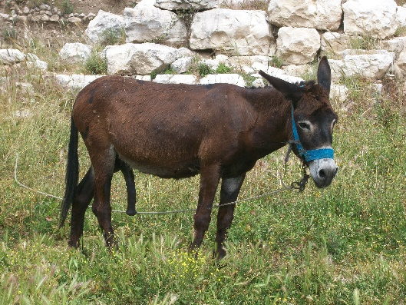
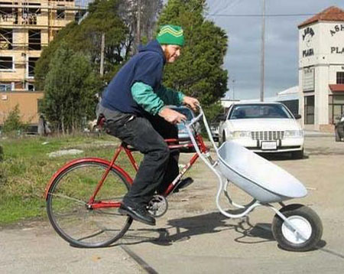
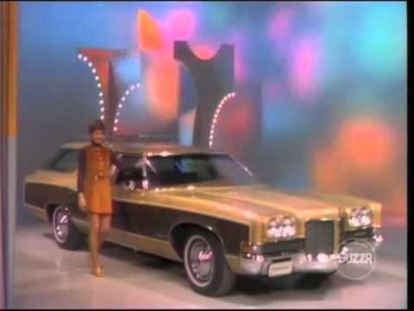
Second Coming
2 PETER
Second Coming
Preterits
Futurist
Historicist
Past
Present
Future

